Slide 1

Upgradability Patterns for Ethereum Smart Contracts

Slide 2
Upgradability Patterns
Proxy pattern
Diamond pattern

Slide 3
Upgradability Patterns
The diamond pattern can be considered an improvement on the proxy pattern. Diamond patterns differ from proxy patterns because the diamond proxy contract can delegates function calls to more than one logic contract.
Therefore, we are going to focus on diamond contracts - the most interesting upgradability pattern.

Slide 4
WHAT IS A SMART CONTRACT UPGRADE?
Smart Contracts
immutability
upgradability
trustlessness
security
decentralization

Slide 5
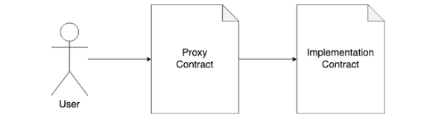
WHAT IS A SMART CONTRACT UPGRADE?
immutability
upgradability
immutability
upgradability

Slide 6
HOW IS IT HELPFUL?
Write smart contracts with virtually no size limit
A single contract can’t exceed the 24KB maximum contract size.
A single address for unlimited contract functionality
No need to redeploy existing functionality.
Part of a contract can be added/replaced/removed while leaving

Slide 7
Technical Background
I don’t have func function.
call fallback() function
call Proxy.func()
fallback() works as router.
Implemented Contracts

Slide 8
Technical Background
How to call another contract function
as its internal function
Solution: delegatecall
It doesn’t affect msg.sender, msg.value.

Slide 9
Technical Background
fallback() external payable {
address facet = selectorTofacet[msg.sig];
require(facet != address(0));
assembly {
calldatacopy(0, 0, calldatasize())
let result := delegatecall(gas(), facet, 0, calldatasize(), 0, 0)
returndatacopy(0, 0, returndatasize())
switch result
case 0 {revert(0, returndatasize())}
default {return (0, returndatasize())}
}
}

Slide 10
Facets, State Variables and Diamond Storage
library LibA {
struct DiamondStorage {
address owner;
bytes32 dataA;
}
function diamondStorage() returns (DiamondStorage storage ds) {
bytes32 storagePosition =
keccak256("diamond.storage.LibA");
assembly {ds.slot := storagePosition}
}
}
The storage locations of state variables do not conflict.

Slide 11
Facets, State Variables and Diamond Storage
contract FacetA {
function setDataA(bytes32 _dataA) external {
LibA.DiamondStorage storage ds = LibA.diamondStorage();
require(ds.owner == msg.sender, "Must be owner.");
ds.dataA = _dataA;
}
function getDataA() external view returns (bytes32) {
return LibA.diamondStorage().dataA;
}
}

Slide 12
AppStorage
Facet4
Facet3
App Storage
Facet2
Facet1

Slide 13
AppStorage
import "./AppStorage.sol"
contract StakingFacet {
AppStorage internal s;
function myFacetFunction(uint256 _nextVar) external {
s.total = s.firstVar + _nextVar;
}
}
AppStorage is always located at position 0 in contract storage.

Slide 14
Features
Diamonds Can Use Other Contract Storage Strategies.
Facets Can Share State and Functionality.
Facets are Reusable and Composable.

Slide 15
Confused?

Slide 16
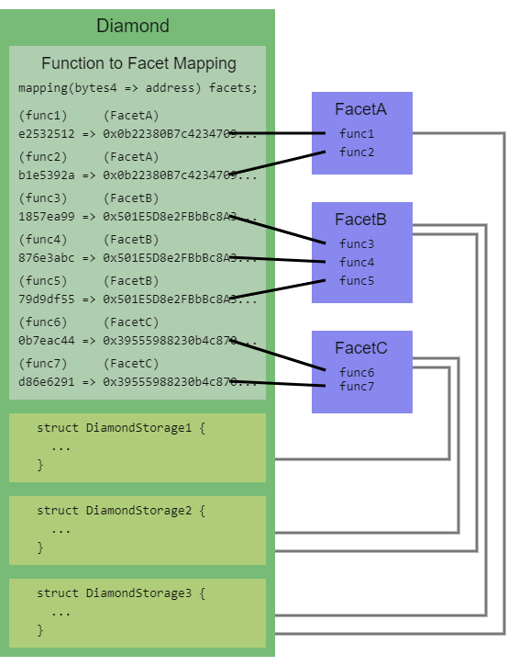
Let’s take it easy.
Diagrams of Diamond Contract
The Proxy contract contains a dictionary.

Slide 17
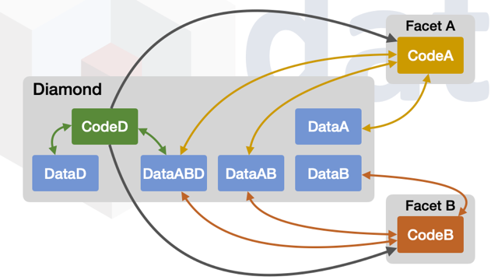
Sample Diamond Contract Diagram 1

Slide 18
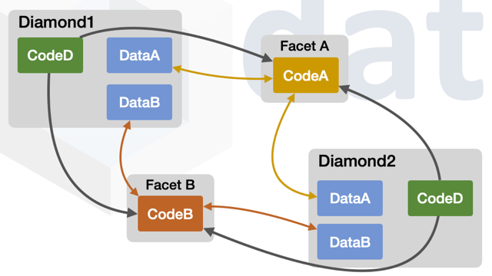
Sample Diamond Contract Diagram 2

Slide 19
Different Kinds of Diamonds
Upgradeable Diamond
Can upgrade any time.
Finished Diamond
The number of upgrades are limited.
Single Cut Diamond
Not upgradable, Why we need this?

Slide 20
Cons of Single Cut Diamond
To solve maximum contract size limit
To modularize large project
To deploy on mainnet after finished working on testnet

Slide 21
Security Considerations
Security
Who
When
Transparency
can add/replace/remove functions
by
transparency

Slide 22
Security Considerations
Several ways who can be limited
Only allow a trusted individual or organization to make diamond upgrades.
Only allow a distributed autonomous organization to make diamond upgrades.
Only allow multi-signature upgrades.
Only allow the end user who owns his own diamond to make upgrades.
Don’t allow anybody to make upgrades by making a single cut diamond.

Slide 23
Security Considerations
Several ways when can be limited
Make a single cut diamond for main network release.
Use an upgradeable diamond until it is certain that no new features are needed and then make it a finished diamond by removing the ability to add/replace/remove functions.
Only in certain periods of time, the diamond can be upgraded.

Slide 24
Security Considerations
Several ways to provide transparency
Publish and make available verified source code used by diamonds and facets.
Provide documentation for diamonds, facets, upgrade plans, and results of upgrades.
Provide tools and/or user interfaces that make your diamonds more visible and understandable.

Slide 25
Learning & References
Diamond Articles
Introduction to EIP-2535 Diamonds
Awesome Diamonds
How to Share Functions Between Facets of a Diamond
Smart Contract Security Audits for EIP-2535 Diamonds Implementations
Why Ethereum Diamonds Need A Standard
Ethereum’s Maximum Contract Size Limit is Solved with EIP-2535 Diamonds
Understanding Diamonds

Slide 26
Learning & References
Diamond Storage Articles
How Diamond Storage Works
AppStorage Pattern for State Variables in Solidity
New Storage Layout For Proxy Contracts and Diamonds
Solidity Libraries Can’t Have State Variables – Oh Yes They Can!
Rules for Diamond Upgrades
Example of Adding New State Variables in Diamond Upgrade
Constructor Functions Don’t Work in Facets

Slide 27
Learning & References
Implementations
Diamond reference implementations
GHST Staking
pie-dao / ExperiPie
Nayms Contracts
Aavegotchi Diamond

Slide 28
Thanks for your time. Oliver Chang

